Slide 1




Tech Summer Camp
Bari-Technologies
Muslim Students League
HTML REVISION AND FINALISING
DAY-5
Salman Ali
ⓒ App Brewery

Slide 2
Revision
Heading tags
Paragraph tag
Center tag
Achor tag (<a>)
Lists
Italics
Bolding

Slide 3
Image inserting in HTML

Slide 4
Tables in HTML

Slide 5
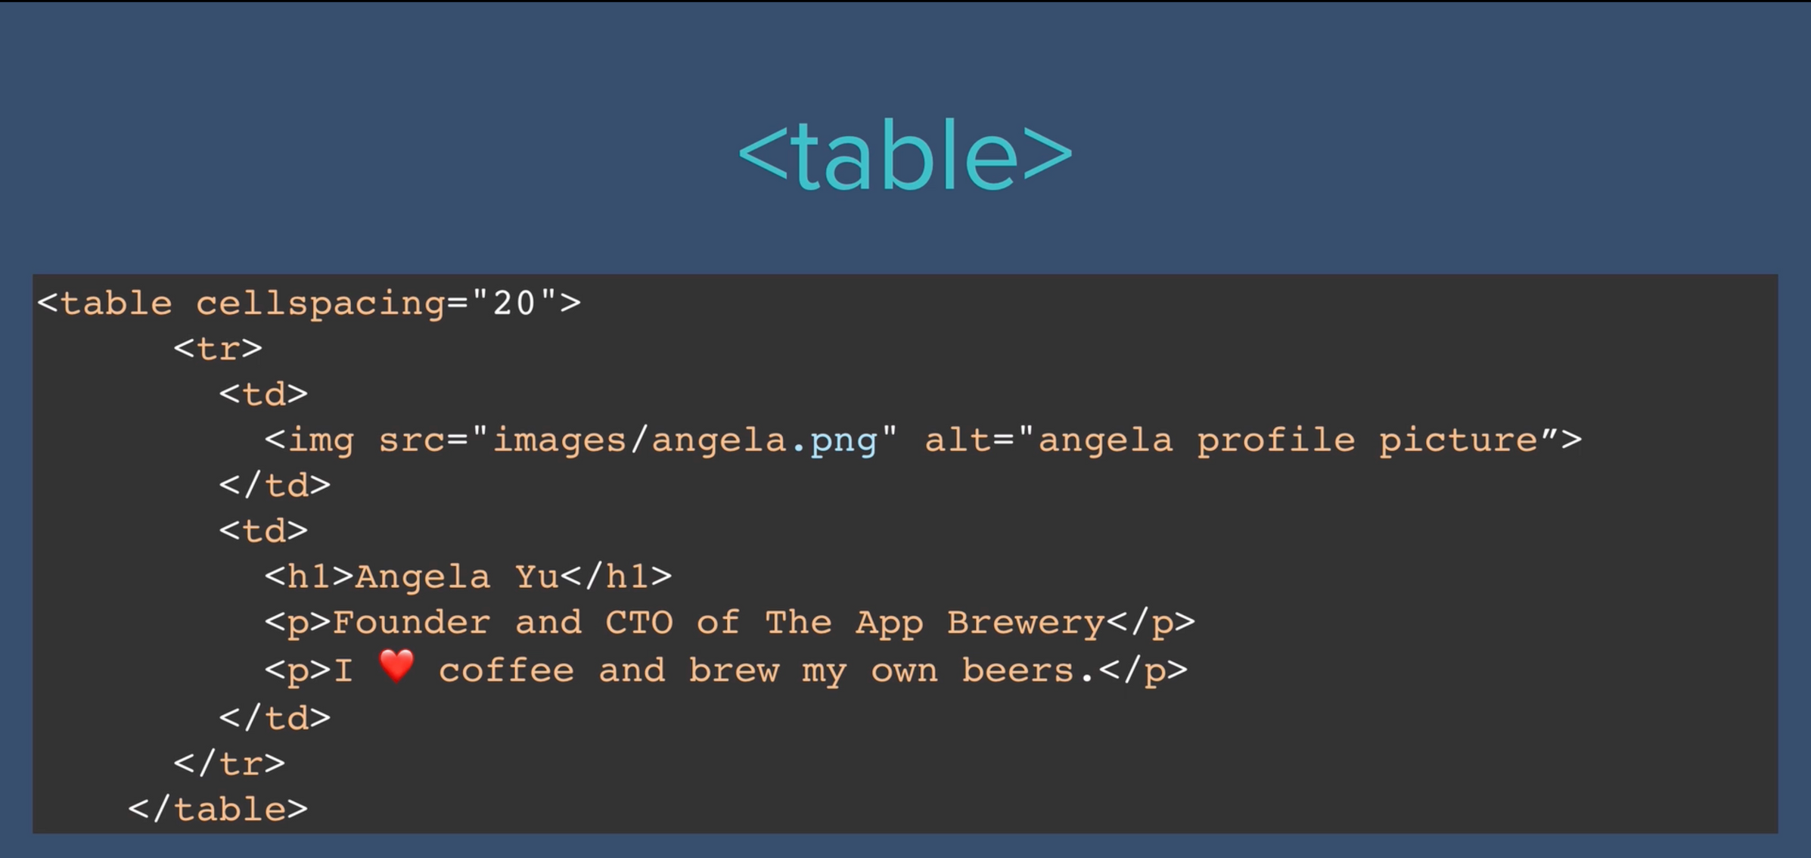

Slide 6
Let’s use our all knowledge and do the following UI

Slide 7
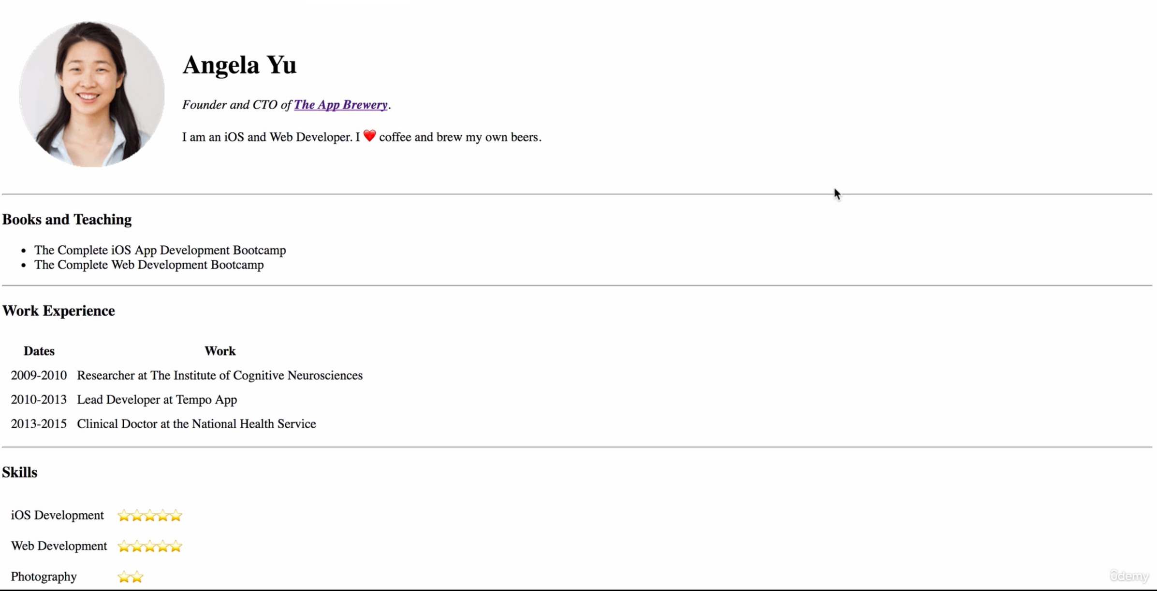

Slide 8
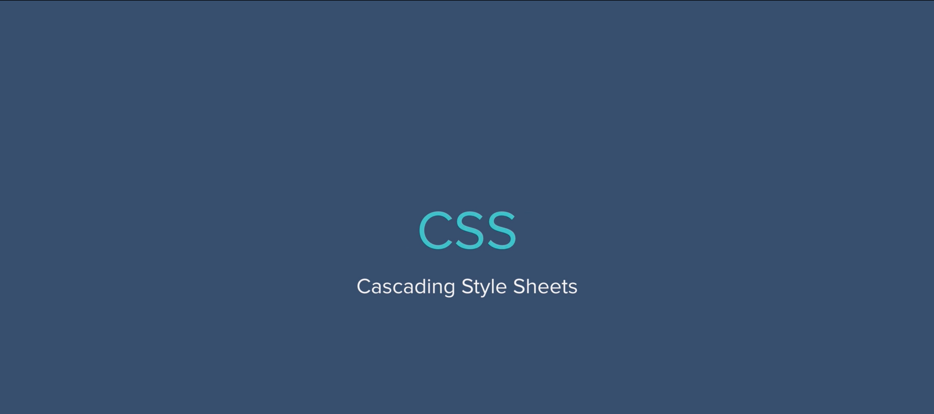
Introduction to

Slide 9
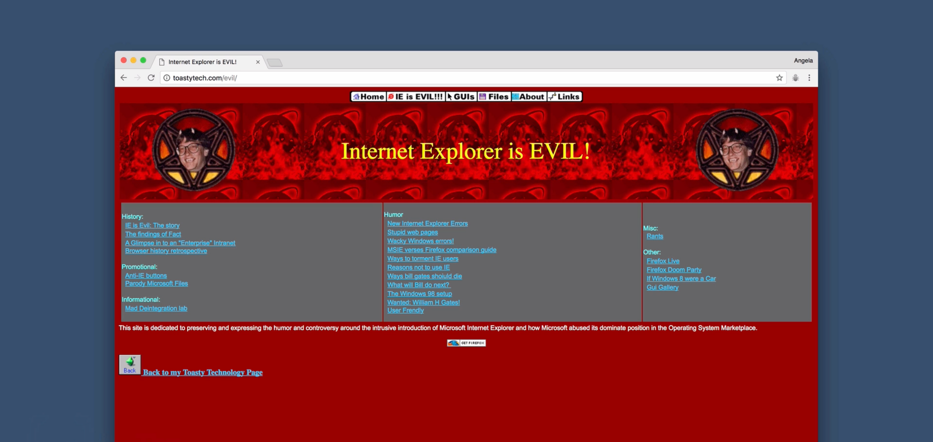

Slide 10
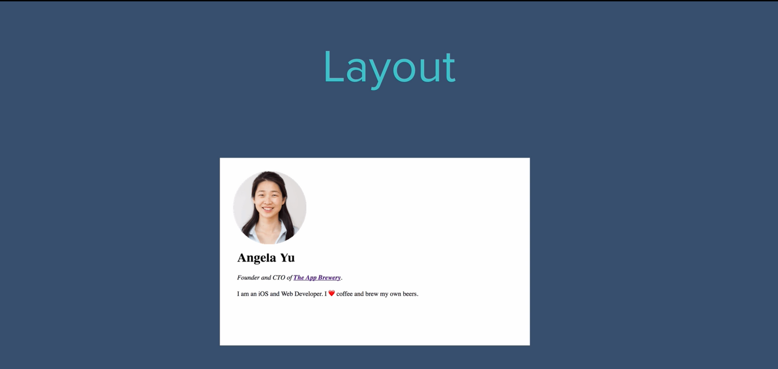

Slide 11
Now, lets use CSS to a view we want

Slide 13
Inline CSS

Slide 14
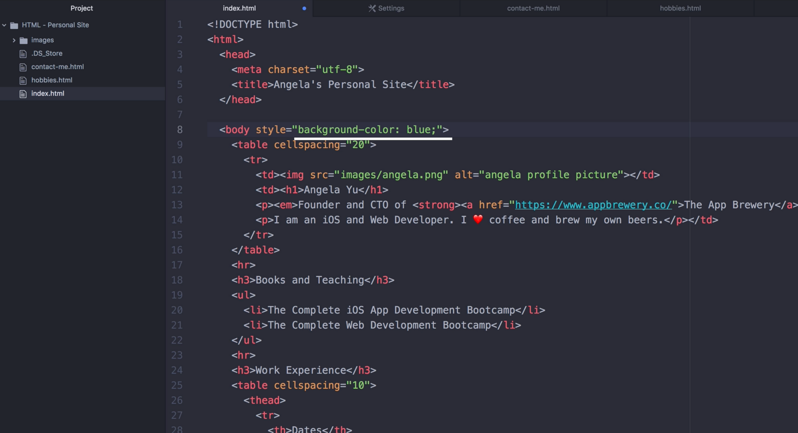

Slide 15
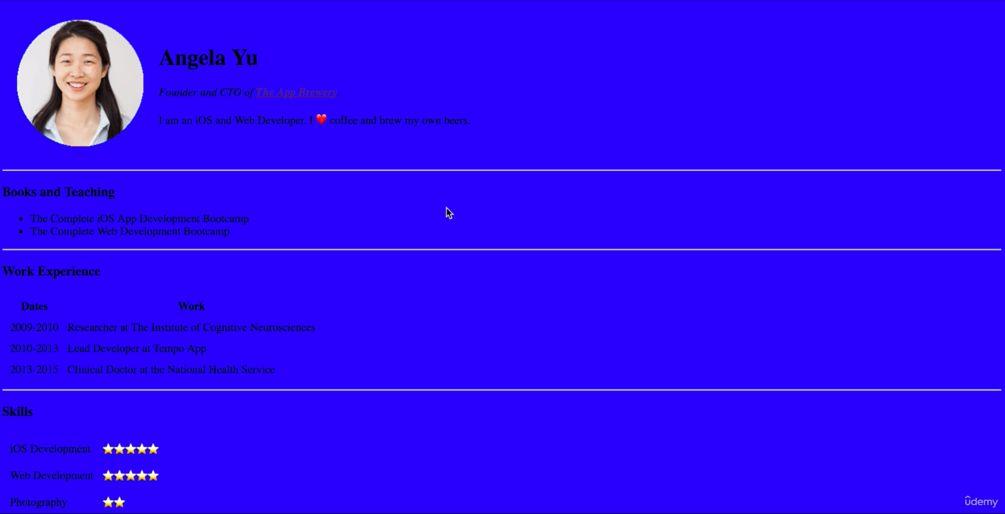

Slide 16
CSS Colors

Slide 17
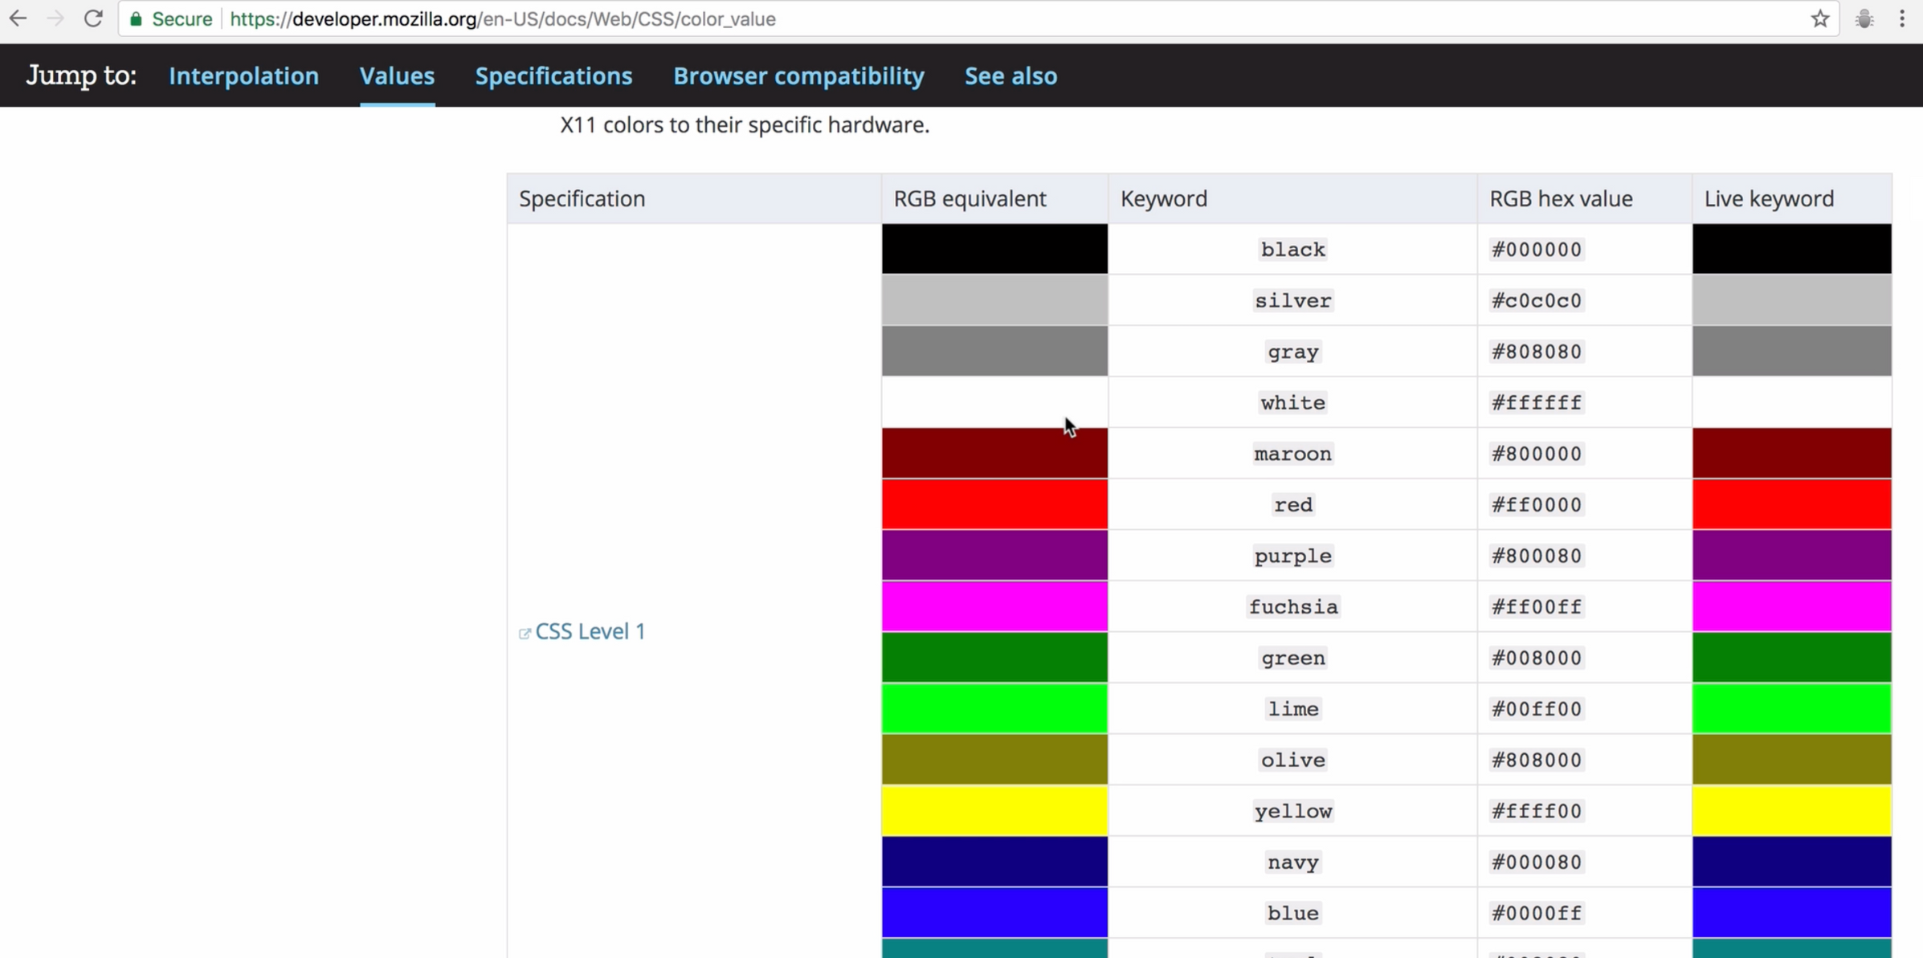

Slide 18
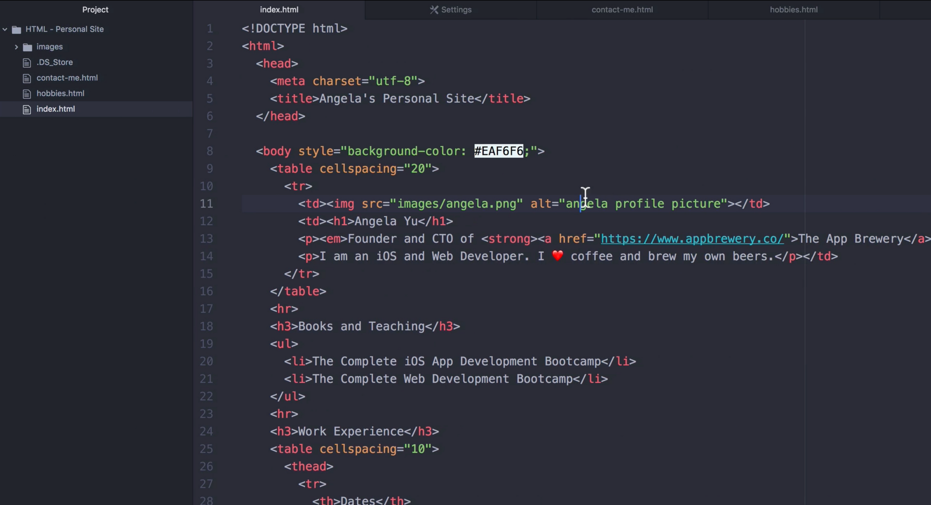

Slide 19
Internal CSS

Slide 20
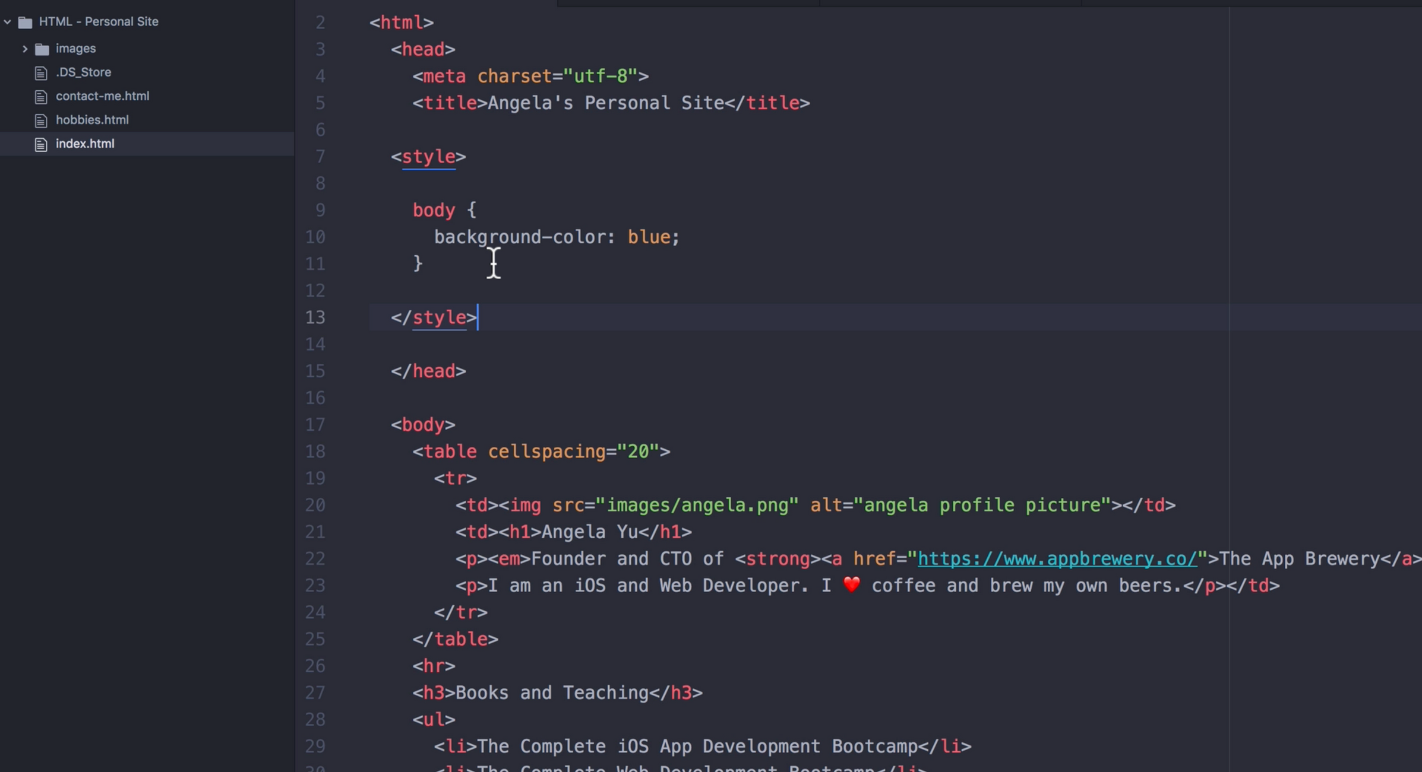

Slide 22
External CSS

Slide 23
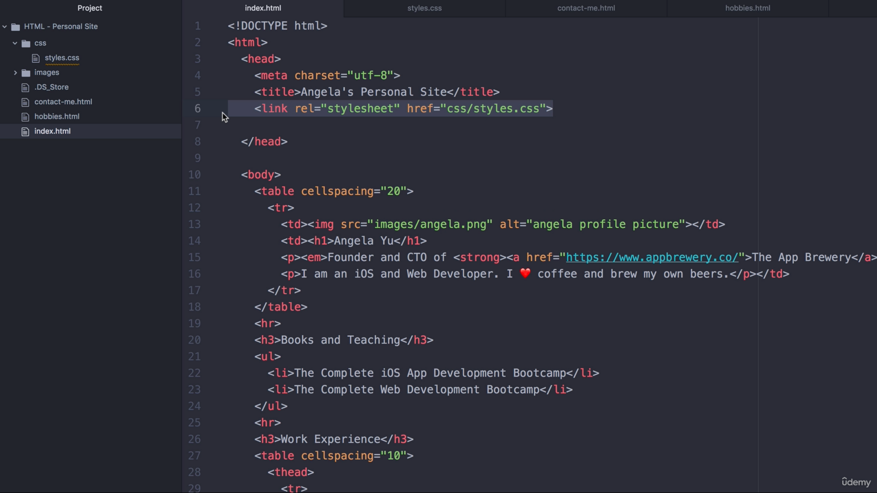

Slide 24
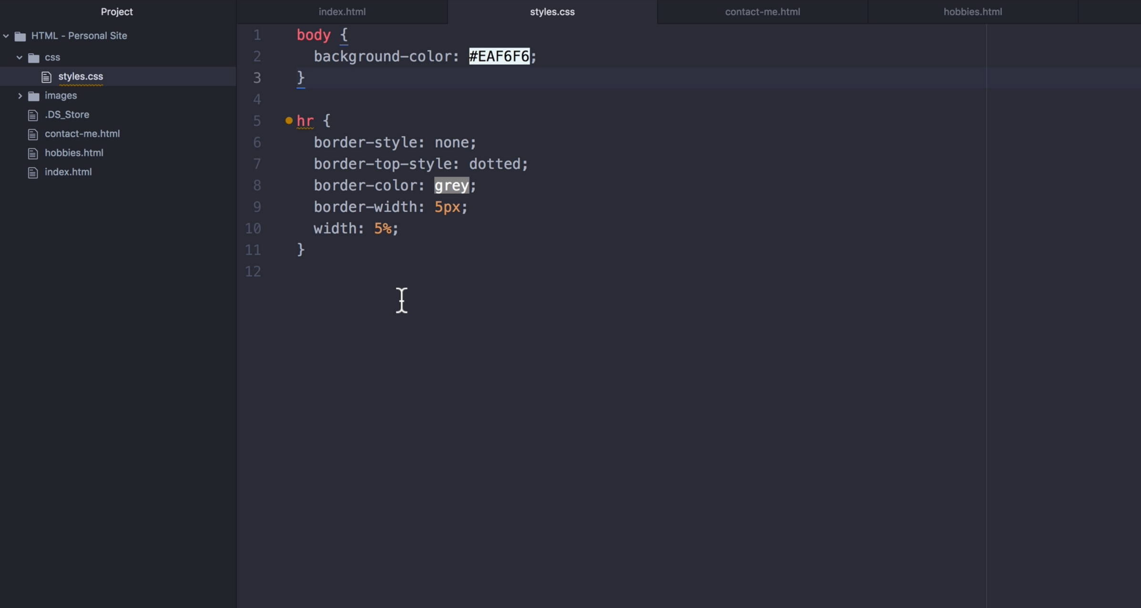

Slide 25
Changing Text color

Slide 26
Debugging CSS
(inspecting page)

Slide 27
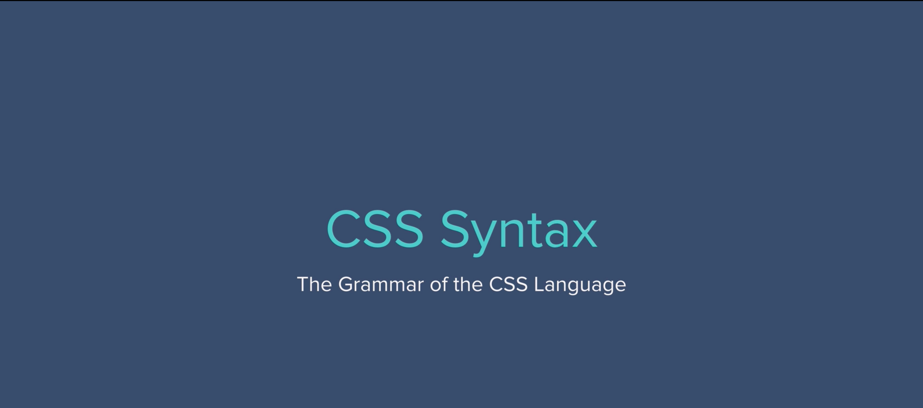

Slide 28
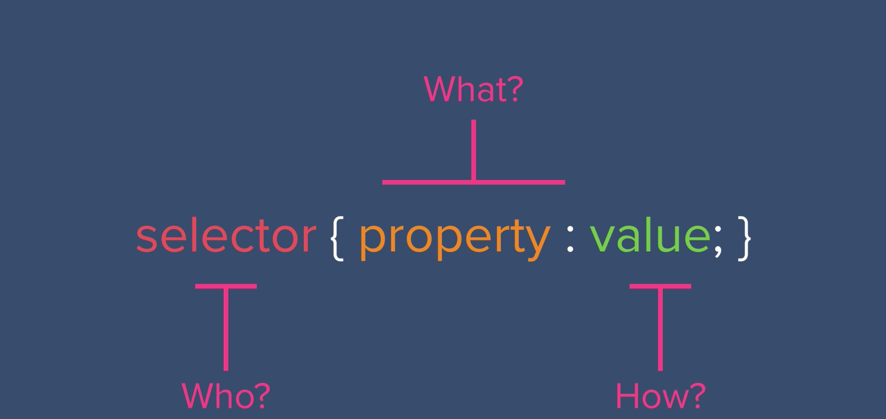

Slide 29
CSS Selectors
(‘class’ and ‘id’)

